Slide 1
DISTRIBUTED AND CLOUD COMPUTING
UNIT – 2 – LOGICAL TIME, GLOBAL STATE, AND SNAPSHOT ALGORITHMS
Notes:
NOTE:
To change the image on this slide, select the picture and delete it. Then click the Pictures icon in the placeholder to insert your own image.

Slide 2
LOGICAL TIME, GLOBAL STATE, AND SNAPSHOT ALGORITHMS
Logical time
Scalar Time
Vector Time
Efficient implementations of vector clocks
Virtual Time
Global state and snapshot recording algorithms:
System model
Snapshot algorithms for FIFO channels and non-FIFO channels

Slide 3
LOGICAL TIME, GLOBAL STATE, AND SNAPSHOT ALGORITHMS
Introduction
A framework for a system of logical clocks
Definition
Implementing logical clocks
Scalar time
Definition
Basic properties
Vector time
Definition
Basic properties
On the size of vector clocks
Efficient implementations of vector clocks
Fowler–Zwaenepoel’s direct-dependency technique

Slide 4
1. LOGICAL TIME, GLOBAL STATE, AND SNAPSHOT ALGORITHMS
Introduction
The concept of causality between events is fundamental to the design and analysis of parallel and distributed computing and operating systems.
Usually causality is tracked using physical time.
However, in distributed systems, it is not possible to have global physical time; it is possible to realize only an approximation of it.
The logical time in distributed systems is used to maintain the consistent ordering of events.
This chapter discusses three ways to implement logical time (e.g., scalar time, vector time, and matrix time) that have been proposed to capture causality between events of a distributed computation.

Slide 5
LOGICAL TIME
A framework for a system of logical clocks
Definition
Implementing logical clocks

Slide 6
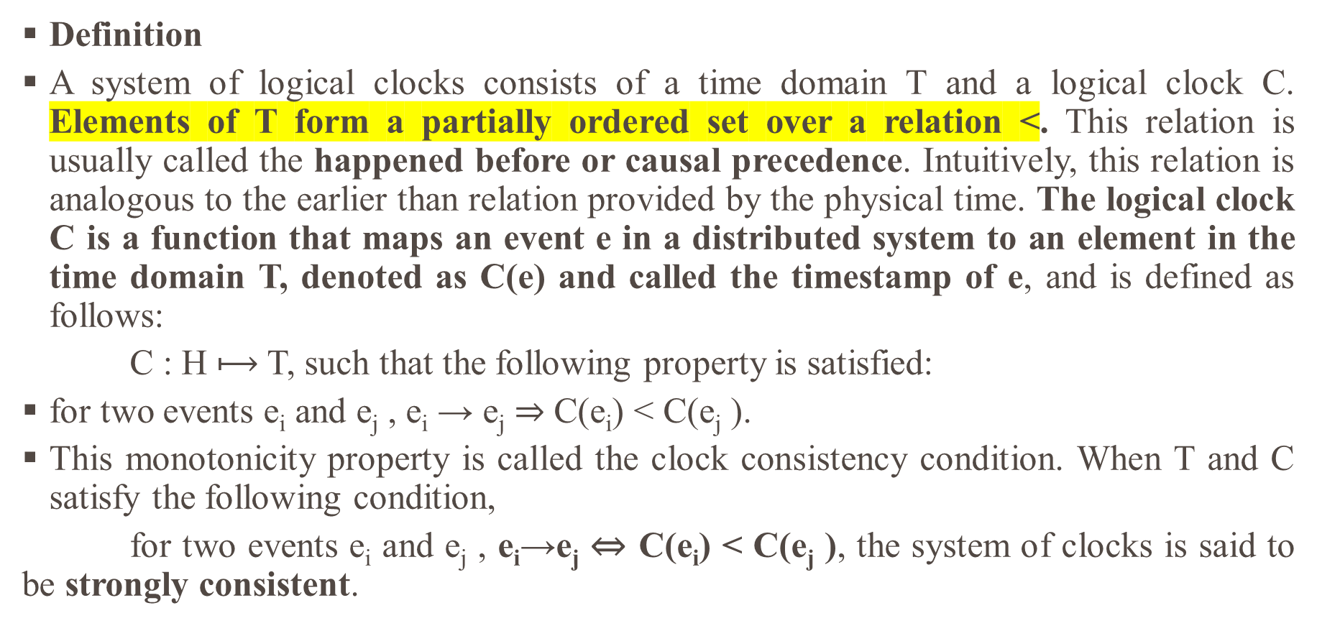
LOGICAL TIME
Definition
A system of logical clocks consists of a time domain T and a logical clock C. Elements of T form a partially ordered set over a relation <. This relation is usually called the happened before or causal precedence. Intuitively, this relation is analogous to the earlier than relation provided by the physical time. The logical clock C is a function that maps an event e in a distributed system to an element in the time domain T, denoted as C(e) and called the timestamp of e, and is defined as follows:
C : H $⟼$ T, such that the following property is satisfied:
for two events e_{i} and e_{j} , e_{i} → e_{j} ⇒ C(e_{i}) < C(e_{j} ).
This monotonicity property is called the clock consistency condition. When T and C satisfy the following condition,
for two events e_{i} and e_{j} , e_{i}→e_{j} ⇔ C(e_{i}) < C(e_{j} ), the system of clocks is said to be strongly consistent.
Notes:
Suppose each machine has a counter for the number of events it has processed; this counter always rises by 1 at each event, so we get the monotonicity property.

Slide 7
LOGICAL TIME
Implementing logical clocks
Implementation of logical clocks requires addressing two issues:
Data structures local to every process to represent logical time
Protocol (set of rules) to update the data structures to ensure the consistency condition.
Each process p_{i} maintains data structures that allow it the following two capabilities:
A local logical clock, denoted by lc_{i}, that helps process p_{i} measure its own progress.
A logical global clock, denoted by gc_{i}, that is a representation of process p_{i}’s local view of the logical global time. It allows this process to assign consistent timestamps to its local events. Typically, lc_{i} is a part of gc_{i}.

Slide 8
LOGICAL TIME
Protocol
The protocol ensures that a process’s logical clock, and thus its view of the global time, is managed consistently.
The protocol consists of the following two rules:
R1 This rule governs how the local logical clock is updated by a process when it executes an event (send, receive, or internal).
R2 This rule governs how a process updates its global logical clock to update its view of the global time and global progress. It dictates what information about the logical time is piggybacked in a message and how this information is used by the receiving process to update its view of the global time.

Slide 9
2. SCALAR TIME
Scalar time
Definition
Basic properties

Slide 10
SCALAR TIME
Definition
The scalar time representation was proposed by Lamport in 1978 as an attempt to totally order events in a distributed system.
Time domain in this representation is the set of non-negative integers.
The logical local clock of a process p_{i} and its local view of the global time are squashed into one integer variable C_{i}.

Slide 11
SCALAR TIME
Definition
Rules R1 and R2 to update the clocks are as follows:
R1 Before executing an event (send, receive, or internal), process p_{i} executes the following:
C_{i} = C_{i} +d (d > 0).
In general, every time R1 is executed, d can have a different value, and this value may be application-dependent. However, typically d is kept at 1 because this is able to identify the time of each event uniquely at a process, while keeping the rate of increase of d to its lowest level.
R2 Each message piggybacks the clock value of its sender at sending time. When a process p_{i} receives a message with timestamp C_{msg}, it executes the following actions:
1. C_{i} = max (Ci, C_{msg});
2. execute R1;
3. deliver the message.

Slide 12
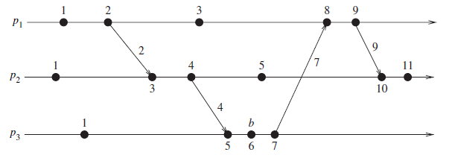
SCALAR TIME
shows the evolution of scalar time with d=1.

Slide 13
SCALAR TIME
Basic properties
Consistency property
Clearly, scalar clocks satisfy the monotonicity and hence the consistency property:
for two events e_{i} and e_{j} , e_{i} →e_{j} =⇒ C(e_{i}) < C(e_{j} ).
Total Ordering
Scalar clocks can be used to totally order events in a distributed system.
The main problem in totally ordering events is that two or more events at different processes may have an identical timestamp. (Note that for two events e₁ and e₂, C(e₁) = C(e₂) =⇒ e₁ || e₂.)

Slide 14
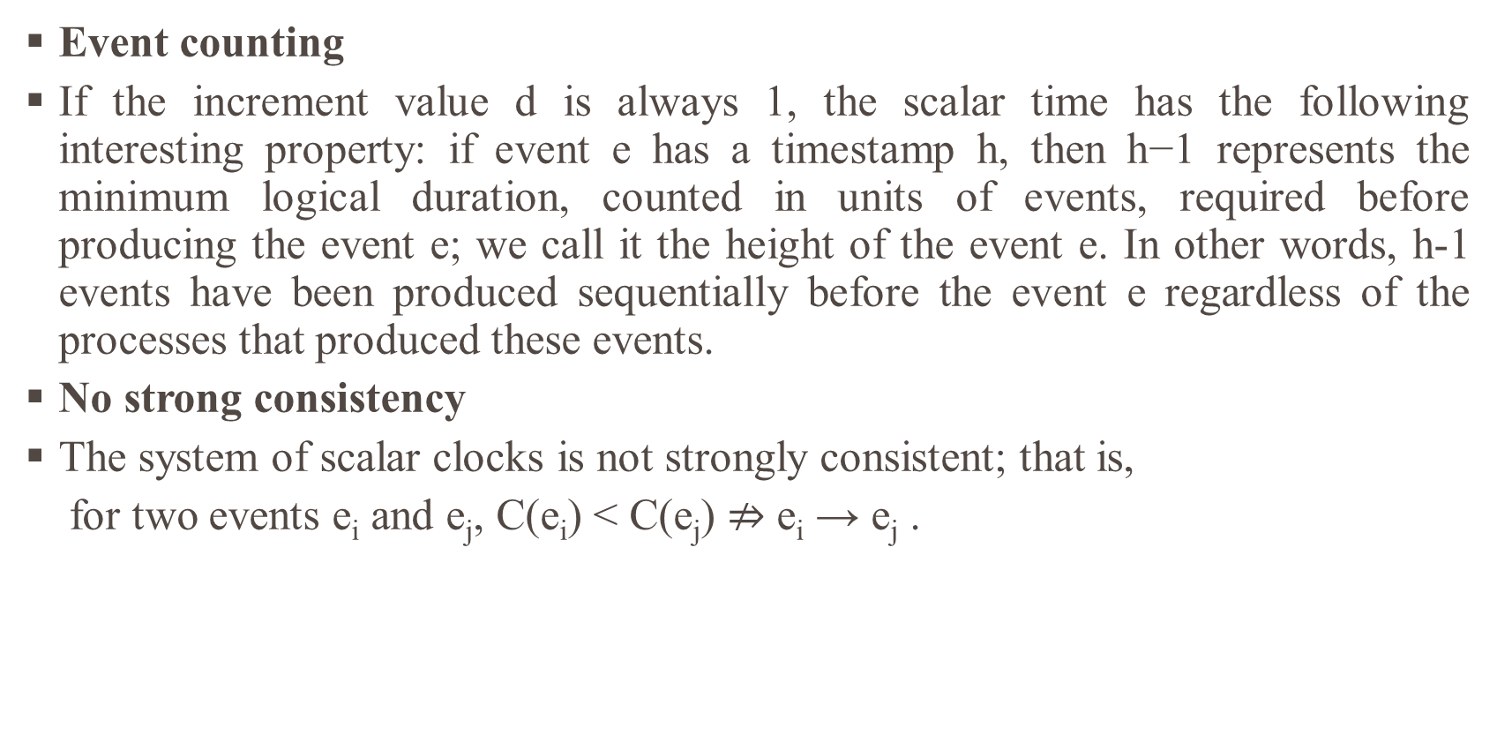
SCALAR TIME
Event counting
If the increment value d is always 1, the scalar time has the following interesting property: if event e has a timestamp h, then h−1 represents the minimum logical duration, counted in units of events, required before producing the event e; we call it the height of the event e. In other words, h-1 events have been produced sequentially before the event e regardless of the processes that produced these events.
No strong consistency
The system of scalar clocks is not strongly consistent; that is,
for two events e_{i} and e_{j}, C(e_{i}) < C(e_{j}) $⇏$ e_{i} → e_{j} .

Slide 15
3.VECTOR TIME
Definition
Basic properties
On the size of vector clocks

Slide 16
VECTOR TIME
Definition
The system of vector clocks was developed independently by Fidge, Mattern, and Schmuck.
In the system of vector clocks, the time domain is represented by a set of n-dimensional non-negative integer vectors.
Each process p_{i} maintains a vector vt_{i}[1..n], where vt_{i}[i] is the local logical clock of p_{i} and describes the logical time progress at process p_{i}.
vt_{i}[j] represents process p_{i}’s latest knowledge of process p_{j} local time.
If vt_{i}[j] = x, then process p_{i} knows that local time at process p_{j} has progressed till x.
The entire vector vt_{i} constitutes p_{i}’s view of the global logical time and is used to timestamp events.

Slide 17
VECTOR TIME
Definition
Process pi uses the following two rules R1 and R2 to update its clock:
R1 Before executing an event, process pi updates its local logical time as follows: vt_{i}[i] = vt_{i}[i]+d (d > 0)
R2 Each message m is piggybacked with the vector clock vt of the sender process at sending time. On the receipt of such a message (m, vt), process pi executes the following sequence of actions:
1. update its global logical time as follows:
1 ≤ k ≤ n : vt_{i} [k] := max(vt_{i}[k], v_{t}[k]);
2. execute R1;
3. deliver the message m.

Slide 18
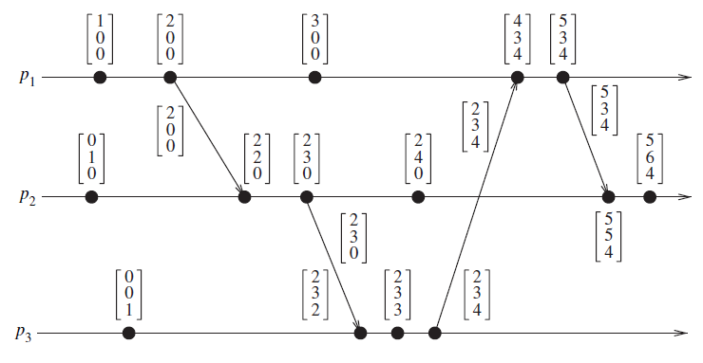
VECTOR TIME
Evolution of vector time

Slide 19
VECTOR TIME
Basic properties
Isomorphism
Recall that relation “→” induces a partial order on the set of events that are produced by a distributed execution.
If events in a distributed system are timestamped using a system of vector clocks, we have the following property.
If two events x and y have timestamps vh and vk, respectively, then
x → y ⇔ vh < vk
x || y ⇔ vh || vk
Thus, there is an isomorphism between the set of partially ordered events produced by a distributed computation and their vector timestamps.

Slide 20
VECTOR TIME
Strong consistency
The system of vector clocks is strongly consistent; thus, by examining the vector timestamp of two events, we can determine if the events are causally related.
Event counting
If d is always 1 in rule R1, then the ith component of vector clock at process p_{i}, vt_{i}[i], denotes the number of events that have occurred at pi until that instant.
Applications
Since vector time tracks causal dependencies exactly, it finds a wide variety of applications.
A brief historical perspective of vector clocks
Although the theory associated with vector clocks was first developed in 1988 independently by Fidge and Mattern, vector clocks were informally introduced and used by several researchers before this.

Slide 21
VECTOR TIME
On the size of vector clocks
An important question to ask is whether vector clocks of size n are necessary in a computation consisting of n processes. To answer this, we examine the usage of vector clocks.
A vector clock provides the latest known local time at each other process. If this information in the clock is to be used to explicitly track the progress at every other process, then a vector clock of size n is necessary.
A popular use of vector clocks is to determine the causality between a pair of events. Given any events e and f, the test for e ≺ f if and only if T(e) < T(f), which requires a comparison of the vector clocks of e and f.
Notes:
the ≺ symbol, known as "Precedes”

Slide 22
4. Efficient implementations of vector clocks
If the number of processes in a distributed computation is large, then vector clocks will require piggybacking of huge amount of information in messages for the purpose of disseminating time progress and updating clocks.
The message overhead grows linearly with the number of processors in the system and when there are thousands of processors in the system, the message size becomes huge even if there are only a few events occurring in few processors.
In this section, we discuss efficient ways to maintain vector clocks; similar techniques can be used to efficiently implement matrix clocks.

Slide 23
Efficient implementations of vector clocks
Charron-Bost showed that if vector clocks have to satisfy the strong consistency property, then in general vector timestamps must be at least of size n, the total number of processes.
Therefore, in general the size of a vector timestamp is the number of processes involved in a distributed computation; however, several optimizations are possible and next, we discuss techniques to implement vector clocks efficiently.
Singhal–Kshemkalyani’s differential technique
Fowler–Zwaenepoel’s direct-dependency technique

Slide 24
Efficient implementations of vector clocks
Singhal–Kshemkalyani’s differential technique
Singhal–Kshemkalyani’s differential technique is based on the observation that between successive message sends to the same process, only a few entries of the vector clock at the sender process are likely to change.
This is more likely when the number of processes is large because only a few of them will interact frequently by passing messages.
In this technique, when a process pi sends a message to a process pj , it piggybacks only those entries of its vector clock that differ since the last message sent to pj.
This technique also requires that the communication channels follow FIFO discipline for message delivery.

Slide 25
Efficient implementations of vector clocks
Singhal–Kshemkalyani’s differential technique
The technique works as follows: if entries i₁, i₂, … , i_{n1} of the vector clock at p_{i} have changed to v₁, v₂, … v_{n1}, respectively, since the last message sent to p_{j}, then process pi piggybacks a compressed timestamp of the form
{(i₁, v₁), (i₂, v₂), … (i_{n1}, v_{n1})} to the next message to p_{j}. When p_{j} receives this message, it updates its vector clock as follows:
vt_{i}[i_{k}] = max(vt_{i}[i_{k}], v_{k}) for k = 1, 2, … n₁.

Slide 26
Efficient implementations of vector clocks
Singhal–Kshemkalyani’s differential technique
Singhal and Kshemkalyani developed a clever technique that cuts down this storage overhead at each process to O(n).
The technique works in the following manner: process p_{i} maintains the following two additional vectors:
LS_{i}[1… n] (‘Last Sent’):
Ls_{i} [j] indicates the value of vt_{i}[i] when process p_{i} last sent a message to process p_{j}.
LU_{i}[1… n] (‘Last Update’):
Lu_{i}[j] indicates the value of vt_{i}[i] when process p_{i} last updated the entry vt_{i}[j].

Slide 27
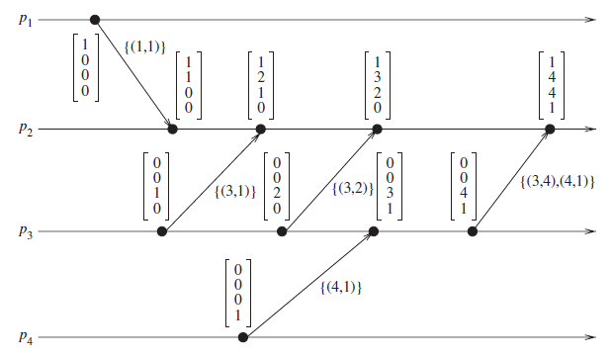
Efficient implementations of vector clocks
Singhal–Kshemkalyani’s differential technique
Vector clocks progress in Singhal–Kshemkalyani technique

Slide 28
Efficient implementations of vector clocks
Fowler–Zwaenepoel’s direct-dependency technique
Fowler–Zwaenepoel direct dependency technique reduces the size of messages by transmitting only a scalar value in the messages.
No vector clocks are maintained on-the-fly. Instead, a process only maintains information regarding direct dependencies on other processes.
A vector time for an event, which represents transitive dependencies on other processes, is constructed off-line from a recursive search of the direct dependency information at processes.
Each process p_{i} maintains a dependency vector D_{i}. Initially, D_{i}[j] = 0 for j = 1,… n.

Slide 29
Efficient implementations of vector clocks
Fowler–Zwaenepoel’s direct-dependency technique
D_{i} is updated as follows:
Whenever an event occurs at p_{i}, D_{i}[i] = D_{i}[i] + 1. That is, the vector component corresponding to its own local time is incremented by one.
When a process p_{i} sends a message to process p_{j}, it piggybacks the updated value of D_{i}[i] in the message.
When p_{i} receives a message from p_{j} with piggybacked value d, p_{i} updates its dependency vector as follows: D_{i}[j]:= max{D_{i}[j], d}.

Slide 30
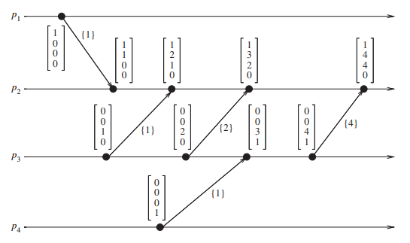
Efficient implementations of vector clocks
Vector clock progress in Fowler–Zwaenepoel technique

Slide 31
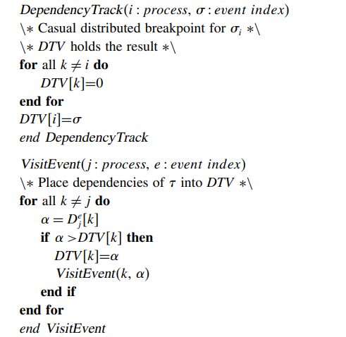
RECURSIVE DEPENDENCY TRACE ALGORITHM

Slide 32
RECURSIVE DEPENDENCY TRACE ALGORITHM
Let us illustrate the recursive dependency trace algorithm by by tracking the dependencies of fourth event at process p2.
The algorithm is invoked as DependencyTrack(2 4). DTV is initially set to < 0 4 0 0 > by DependencyTrack. It then calls VisitEvent(2 4).
The values held by D₂⁴ are < 1 4 4 0 >. So, DTV is now updated to < 1 4 0 0 > and VisitEvent(1 1) is called. The values held by D₁ ¹ are < 1 0 0 0 >. Since none of the entries are greater than those in DTV, the algorithm returns.
Again the values held by D₂ ⁴ are checked and this time entry 3 is found to be greater in D₂⁴ than DTV.
So, DTV is updated as < 1 4 4 0 > and VisitEvent(3 4) is called. The values held by D₃⁴ are < 0 0 4 1 >.

Slide 33
RECURSIVE DEPENDENCY TRACE ALGORITHM
Since entry 4 of D₃⁴ is greater than that of DTV, it is updated as < 1 4 4 1 > and VisitEvent(4 1) is called.
Since none of the entries in D₄¹ : < 1 0 0 0 > are greater than those of DTV, the algorithm returns to VisitEvent(2 4).
Since all the entries have been checked, VisitEvent(2 4) is exited and so is DependencyTrack. At this point, DTV holds < 1 4 4 1 >, meaning event 4 of process p2 is dependent upon event 1 of process p1, event 4 of process p3 and event 1 in process p4.
Also, it is dependent on events that precede event 4 of process p3 and these dependencies could be obtained by invoking the DependencyTrack algorithm on fourth event of process p3. Thus, all the causal dependencies could be tracked off-line.

Slide 34
5. VIRTUAL TIME
The virtual time system is a paradigm for organizing and synchronizing distributed systems using virtual time.
Virtual time definition
Comparison with Lamport’s logical clocks
Time warp mechanism
Global control mechanism

Slide 35
VIRTUAL TIME
Virtual time definition:
Virtual time is a global, one-dimensional, temporal coordinate system on a distributed computation to measure the computational progress and to define synchronization.
A virtual time system is a distributed system executing in coordination with an imaginary virtual clock that uses virtual time.
Virtual times are real values that are totally ordered by the less than relation, “<”.
Virtual time is implemented as a collection of several loosely synchronized local virtual clocks.
As a rule, these local virtual clocks move forward to higher virtual times; however, occasionally they move backwards.

Slide 36
VIRTUAL TIME
In a distributed system, processes run concurrently and communicate with each other by exchanging messages. Every message is characterized by four values:
(i) name of the sender;
(ii) virtual send time;
(iii) name of the receiver;
(iv) virtual receive time.
Virtual time systems are subject to two semantic rules similar to Lamport’s clock conditions:
Rule 1 Virtual send time of each message < virtual receive time of that message.
Rule 2 Virtual time of each event in a process < virtual time of next event in that process.

Slide 37
VIRTUAL TIME
Characteristics of virtual time
Virtual time systems are not all isomorphic; they may be either discrete or continuous.
Virtual time may be only partially ordered (in this implementation, total order is assumed.)
Virtual time may be related to real time or may be independent of it.
Virtual time systems may be visible to programmers and manipulated explicitly as values, or hidden and manipulated implicitly according to some system-defined discipline
Virtual times associated with events may be explicitly calculated by user programs or they may be assigned by fixed rules.

Slide 38
VIRTUAL TIME
Comparison with Lamport’s logical clocks
Lamport showed that in real-time temporal relationships “happens before” and “happens after,” operationally definable within a distributed system, form only a partial order, not a total order, and concurrent events are incomparable under that partial order.
Time warp mechanism
In the implementation of virtual time using the time warp mechanism, the virtual receive time of a message is considered as its timestamp.
The necessary and sufficient conditions for the correct implementation of virtual time are that each process must handle incoming messages in timestamp order.
The Time Warp algorithm is an inverse of the Lamport algorithm where they mainly have the time assigned to the event and rollback if any discrepancy is found

Slide 39
Time Warp algorithm
Each process maintains its own virtual clock which is changed only between events. Each process has 3 queues; the input message queue, output message queue and the state queue. Keeping in mind the virtual time rules, the each event in the local queue of the process should always be in increasing order.
There are extremely probable cases where events with virtual time lesser than the current time in the process may arrive, which violates the rules of virtual time. In such cases, the time warp algorithm follows the lookahead-rollback algorithm, which results in rolling back to the point where the incoming message fits appropriately with the processes’ virtual time and remaining messages have to be replayed in the correct sequence.

Slide 40
ROLL BACK
The rollback of messages cannot be narrowed down to a single processor alone since the messages sent in the wrong sequence also affects other processes which maintain their own queues.
Hence, there has to be a rollback for the error messages in other processes as well which are connected to each other.
Other processes which don’t have any direct or indirect connection to the message with error sequence won’t be affected, thus leading to a lesser network rework effect.

Slide 41
ROLL BACK
For rollbacks, there is a concept of Antimessages in the system which can also be used for other purposes. All fields of messages and antimessages are the same except for one field, which is the sign of the message. All messages which have been sent to other processes have a (+) sign and their Antimessages have a (-) sign. Whenever a message is sent, the message is stored in the receiver’s input queue and the antimessage is stored in the sender’s output queue.
Whenever a message and Antimessages exist in the same queue, both the messages cancel each other out and are therefore removed.

Slide 42
VIRTUAL TIME
Antimessages and the rollback mechanism
Runtime representation of a process is composed of the following:
Process name: Virtual spaces coordinate which is unique in the system.
Local virtual clock: Virtual time coordinate
State: Data space of the process including execution stack, program counter, and its own variables
State queue: Contains saved copies of process’s recent states as rollback with the time warp mechanism requires the state of the process being saved. It is not necessary to retain states all the way from the beginning of the virtual time.

Slide 43
VIRTUAL TIME
Antimessages and the rollback mechanism
Input queue Contains all recently arrived messages in order of virtual receive time. Processed messages from the input queue are not deleted as they are saved in the output queue with a negative sign (Antimessage) to facilitate future rollbacks.
Output queue Contains negative copies of messages that the process has recently sent in virtual send time order. They are needed in case of a rollback.

Slide 44
VIRTUAL TIME
Global control mechanism
The global control mechanism resolves the following issues:
System global progress amidst rollback activity?
Detection of global termination?
Errors, I/O handling on rollbacks?
Running out of memory while saving copies of messages?
How these issues are resolved by the global control mechanism will be discussed later; first we discuss the important concept of global virtual time.

Slide 45
VIRTUAL TIME
Global control mechanism
Global virtual time
The concept of global virtual time (GVT) is central to the global control mechanism. Global virtual time is a property of an instantaneous global snapshot of system at real time “r” and is defined as follows:
Global virtual time (GVT) at real time r is the minimum of:
All virtual times in all virtual clocks at time r; and
The virtual send times of all messages that have been sent but have not yet been processed at time “r”.

Slide 46
VIRTUAL TIME
Applications of GVT
GVT finds several applications in a virtual time system using the time warp mechanism.
Memory management and flow control
Normal termination detection
Error handling
Input and output
Snapshots and crash recovery

Slide 47
6. Global state and snapshot recording algorithms:
Recording the global state of a distributed system on-the-fly is an important paradigm when one is interested in analyzing, testing, or verifying properties associated with distributed executions.
Unfortunately, the lack of both a globally shared memory and a global clock in a distributed system, added to the fact that message transfer delays in these systems are finite but unpredictable, makes this problem non-trivial.
Introduction
System model and definitions
System model
A consistent global state
Interpretation in terms of cuts
Issues in recording a global state
Snapshot algorithms for FIFO channels
Chandy–Lamport algorithm
Properties of the recorded global state

Slide 48
Global state and snapshot recording algorithms:
Introduction
A distributed computing system consists of spatially separated processes that do not share a common memory and communicate asynchronously with each other by message passing over communication channels.
Each component of a distributed system has a local state.
The state of a process is characterized by the state of its local memory and a history of its activity.
The state of a channel is characterized by the set of messages sent along the channel less the messages received along the channel.
The global state of a distributed system is a collection of the local states of its components.

Slide 49
Global state and snapshot recording algorithms:
System model and definitions
The system consists of a collection of n processes, p₁, p₂,…, p_{n}, that are connected by channels.
There is no globally shared memory and processes communicate solely by passing messages.
There is no physical global clock in the system.
Message send and receive is asynchronous.
Messages are delivered reliably with finite but arbitrary time delay.
The system can be described as a directed graph in which vertices represent the processes and edges represent unidirectional communication channels.
Let C_{ij} denote the channel from process p_{i} to process p_{j} .

Slide 50
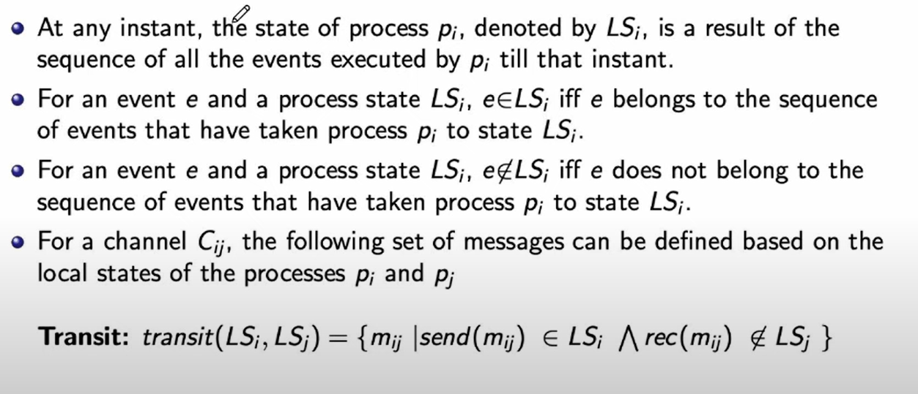
SYSTEM MODEL

Slide 51
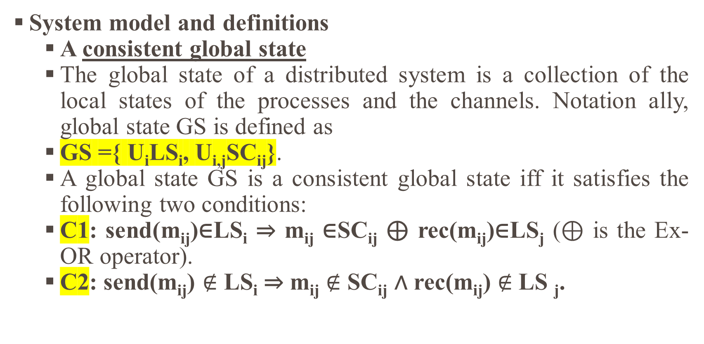
Global state and snapshot recording algorithms:
System model and definitions
A consistent global state
The global state of a distributed system is a collection of the local states of the processes and the channels. Notation ally, global state GS is defined as
GS ={ U_{i}LS_{i}, U_{i,j}SC_{ij}}.
A global state GS is a consistent global state iff it satisfies the following two conditions:
C1: send(m_{ij})∈LS_{i} ⇒ m_{ij} ∈SC_{ij} ⊕ rec(m_{ij})∈LS_{j} (⊕ is the Ex-OR operator).
C2: send(m_{ij}) $∉$ LS_{i} ⇒ m_{ij} $∉$ SC_{ij} ∧ rec(m_{ij}) $∉$ LS _{j}.

Slide 52
Global state and snapshot recording algorithms:
Interpretation in terms of cuts
Cuts in a space–time diagram provide a powerful graphical aid in representing and reasoning about the global states of a computation.
A cut is a line joining an arbitrary point on each process line that slices the space–time diagram into a PAST and a FUTURE.
Recall that every cut corresponds to a global state and every global state can be graphically represented by a cut in the computation’s space–time diagram

Slide 53
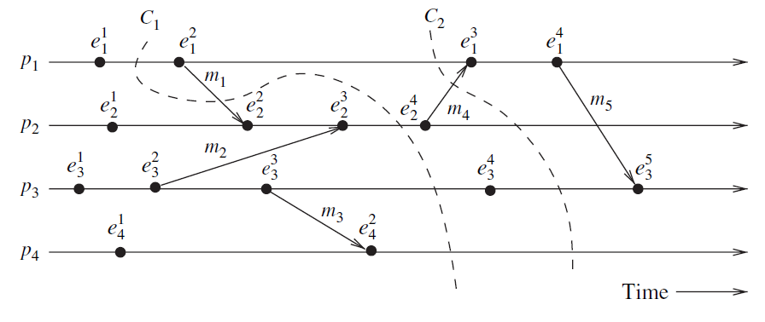
Global state and snapshot recording algorithms:
System model and definitions
Interpretation in terms of cuts
C1: Inconsistent cut
C2: consistent cut

Slide 54
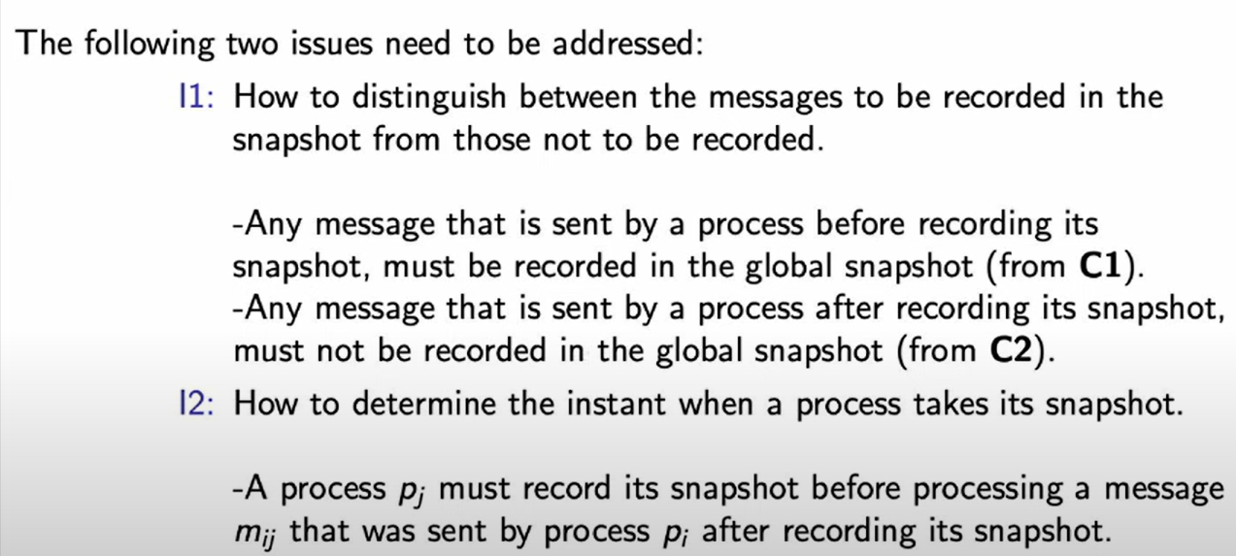
Global state and snapshot recording algorithms:
Issues in recording a global state

Slide 55
7. Snapshot algorithms for FIFO channels
Chandy–Lamport algorithm
The Chandy-Lamport algorithm uses a control message, called a marker.
After a site has recorded its snapshot, it sends a marker along all of its outgoing channels before sending out any more messages.
Since channels are FIFO, a marker separates the messages in the channel into those to be included in the snapshot (i.e., channel state or process state) from those not to be recorded in the snapshot.
This addresses issue I1. The role of markers in a FIFO system is to act as delimiters for the messages in the channels so that the channel state recorded by the process at the receiving end of the channel satisfies the condition C2.

Slide 56
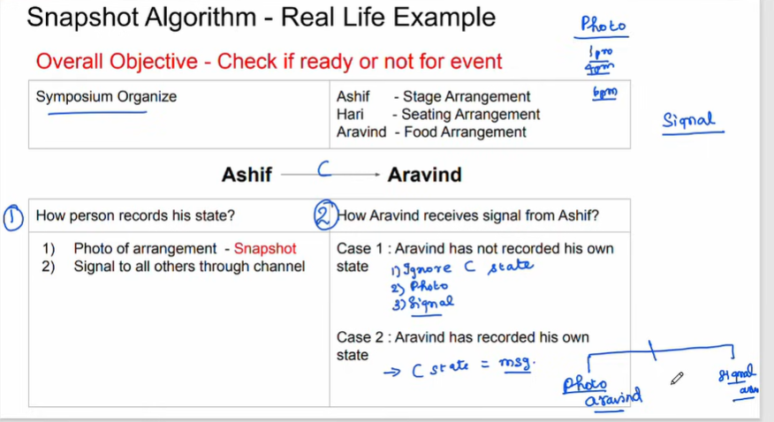
Snapshot algorithms for FIFO channels

Slide 57
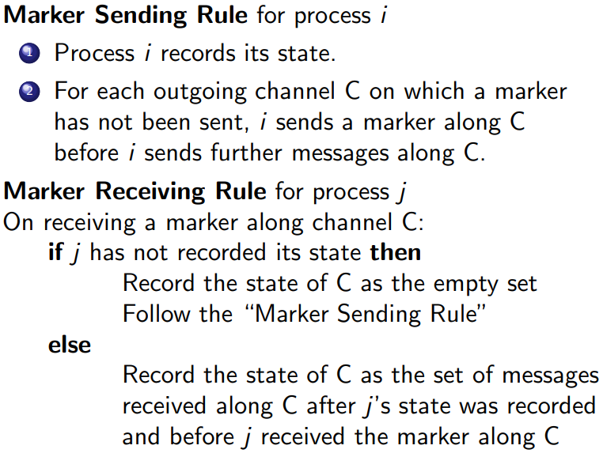
Chandy–Lamport algorithm

Slide 58
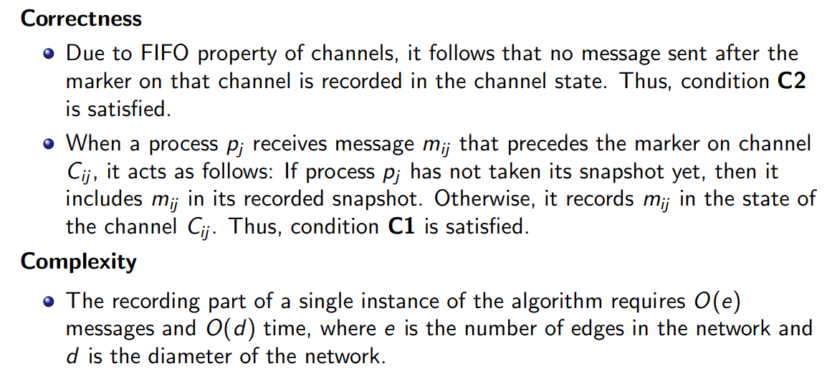
Properties of the recorded global state

Slide 59
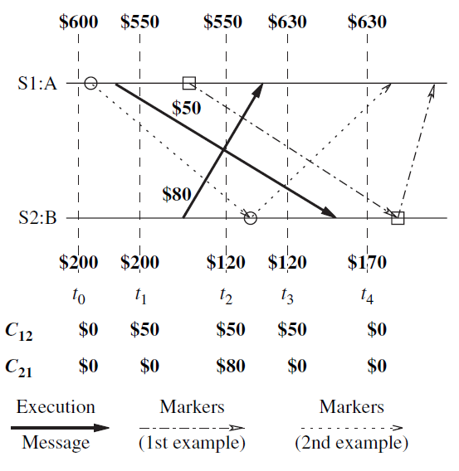
Properties of the recorded global state
Snapshot algorithms for FIFO channels
Timing diagram of two possible executions of the banking example.

Slide 60
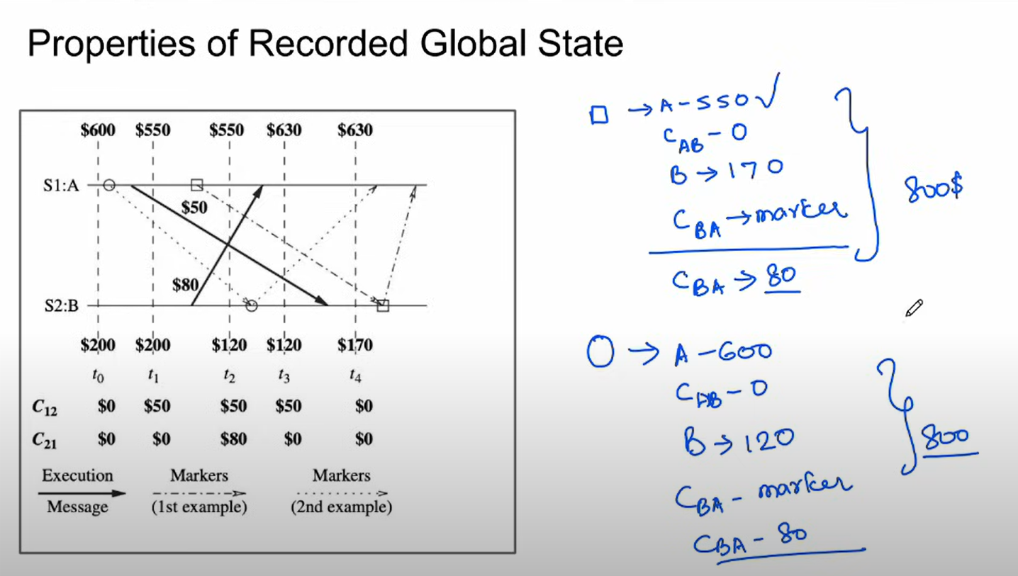
The recorded global state may not correspond to any of the global states that occurred during the computation

Slide 61
Variations of the Chandy–Lamport algorithm
Several variants of the Chandy–Lamport snapshot algorithm followed.
These variants refined and optimized the basic algorithm.
For example, the Spezialetti and Kearns algorithm optimizes concurrent initiation of snapshot collection and efficiently distributes the recorded snapshot.
Venkatesan’s algorithm optimizes the basic snapshot algorithm to efficiently record repeated snapshots of a distributed system that are required in recovery algorithms with synchronous check pointing.

Slide 62
Variations of the Chandy–Lamport algorithm
Spezialetti–Kearns algorithm
There are two phases in obtaining a global snapshot: locally recording the snapshot at every process and distributing the resultant global snapshot to all the initiators.
Spezialetti and Kearns provided two optimizations to the Chandy–Lamport algorithm.
The first optimization combines snapshots concurrently initiated by multiple processes into a single snapshot.

Slide 63
Variations of the Chandy–Lamport algorithm
Venkatesan’s incremental snapshot algorithm
Many applications require repeated collection of global snapshots of the system.
Helary’s wave synchronization method
Helary’s snapshot algorithm incorporates the concept of message waves in the Chandy–Lamport algorithm. A wave is a flow of control messages such that every process in the system is visited exactly once by a wave control message, and at least one process in the system can determine when this flow of control messages terminates.

Slide 64
8. Snapshot algorithms for non-FIFO channels
A FIFO system ensures that all messages sent after a marker on a channel will be delivered after the marker.
This ensures that condition C2 is satisfied in the recorded snapshot if LS_{i}, LS_{j}, and SC_{ij} are recorded as described in the Chandy–Lamport algorithm.
In a non-FIFO system, the problem of global snapshot recording is complicated because a marker cannot be used to delineate messages into those to be recorded in the global state from those not to be recorded in the global state.
In such systems, different techniques have to be used to ensure that a recorded global state satisfies condition C2.
Lai–Yang algorithm
Li et al.’s algorithm
Mattern’s algorithm

Slide 65
Snapshot algorithms for non-FIFO channels
Lai–Yang algorithm
The Lai–Yang algorithm fulfills this role of a marker in a non-FIFO system by using a coloring scheme on computation messages that works as follows:
Every process is initially white and turns red while taking a snapshot. The equivalent of the “marker sending rule” is executed when a process turns red.
Every message sent by a white (red) process is colored white (red). Thus, a white (red) message is a message that was sent before (after) the sender of that message recorded its local snapshot.
Every white process takes its snapshot at its convenience, but no later than the instant it receives a red message.
Every white process records a history of all white messages sent or received by it along each channel.
When a process turns red, it sends these histories along with its snapshot to the initiator process that collects the global snapshot.

Slide 66
Snapshot algorithms for non-FIFO channels
Lai–Yang algorithm
6. The initiator process evaluates transit(LS_{i}, LS_{j}) to compute the state of a channel C_{ij} as given below:
Sc_{ij} =white messages sent by pi on C_{ij} − white messages received by p_{j} on C_{ij}
= { send(m_{ij}) | send(m_{ij}) ∈ LS_{i} } − {rec(m_{ij})|rec(m_{ij}) ∈ LS_{j}}

Slide 67
Snapshot algorithms for non-FIFO channels
Li et al.’s algorithm
Li et al.’s algorithm for recording a global snapshot in a non-FIFO system is similar to the Lai–Yang algorithm. Markers are tagged so as to generalize the red/white colors of the Lai–Yang algorithm to accommodate repeated invocations of the algorithm and multiple initiators.
Every white process records a history, as input and output counters, of all white messages sent or received by it along each channel after the previous snapshot (by the same initiator).
When a process turns red, it sends these histories (i.e., input and output counters) along with its snapshot to the initiator process that collects the global snapshot.
The initiator process computes the state of channel C_{ij} as follows:
SC_{ij}= transit(Ls_{i}, LS_{j}) = TRANSIT_{ij} + (#messages sent on that channel since the last snapshot)− (#messages received on that channel since the last snapshot).

Slide 68
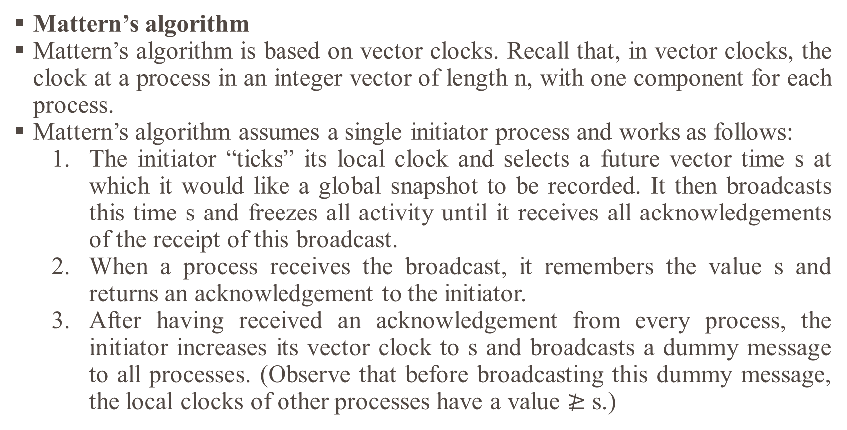
Snapshot algorithms for non-FIFO channels
Mattern’s algorithm
Mattern’s algorithm is based on vector clocks. Recall that, in vector clocks, the clock at a process in an integer vector of length n, with one component for each process.
Mattern’s algorithm assumes a single initiator process and works as follows:
The initiator “ticks” its local clock and selects a future vector time s at which it would like a global snapshot to be recorded. It then broadcasts this time s and freezes all activity until it receives all acknowledgements of the receipt of this broadcast.
When a process receives the broadcast, it remembers the value s and returns an acknowledgement to the initiator.
After having received an acknowledgement from every process, the initiator increases its vector clock to s and broadcasts a dummy message to all processes. (Observe that before broadcasting this dummy message, the local clocks of other processes have a value $≱$ s.)

Slide 69
Snapshot algorithms for non-FIFO channels
Mattern’s algorithm
The receipt of this dummy message forces each recipient to increase its clock to a value ≥ s if not already ≥ s.
Each process takes a local snapshot and sends it to the initiator when (just before) its clock increases from a value less than s to a value ≥ s. Observe that this may happen before the dummy message arrives at the process.
The state of C_{ij} is all messages sent along C_{ij} , whose timestamp is smaller than s and which are received by p_{j} after recording LS_{j} .

Slide 70
REFERENCE
TEXT BOOKS:
Ajay D. Kshemkalyani, Mukesh Singhal, ― Distributed Computing: Principles, Algorithms, and Systems, Cambridge University Press, 2011. (Unit 1, 2, 3).
Douglass E. Comer, ― The Cloud Computing Book: The future of computing explained, CRC Press, 2021. (Unit 4, 5).
REFERENCES:
Arshdeep Bahga, Vijay Madisetti, ― Cloud Computing: A Hands-on Approach‖, Universities Press Private Limited, 2014.
Rajkumar Buyya, Christian Vecchiola, S. ThamaraiSelvi, ―Mastering Cloud Computing, Tata Mcgraw Hill, 2017.
Kai Hwang, Geoffrey C. Fox, Jack G. Dongarra, ―Distributed and Cloud Computing, From Parallel Processing to the Internet of Things, Morgan Kaufmann Publishers, 2012.
Hagit Attiya, Jennifer Welch, ―Distributed Computing: Fundamentals, Simulations and Advanced Topics, John Wiley & Sons, Inc., 2004.

Slide 71

Thank You…

